Slide 1
Vegetable Gardening for Beginners
Colin Burrows
Alachua County Master Gardener

Slide 2
Introduction
~1+ million vegetable gardens in Florida
Spring most popular
Summer least popular
Fall/winter great time
Average size: 300 - 600 sq ft
Major problems: infertile soils, pests, and disorders related to weather

Slide 3
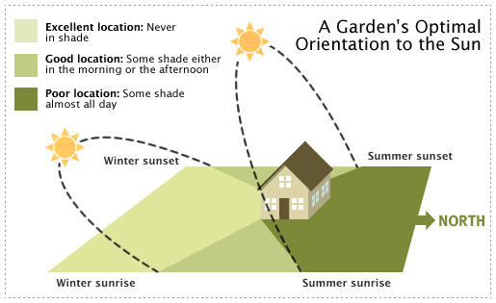
Site Selection
Full sun (> 5-6 hours/day)
Near house & water source
Away from competing tree roots
Well-drained soils
Notes:
Remind audience that angle of sun changes (overhead in summer, in the south in winter). Will they still get enough sun in winter or will trees, buildings, etc. interfere?

Slide 4
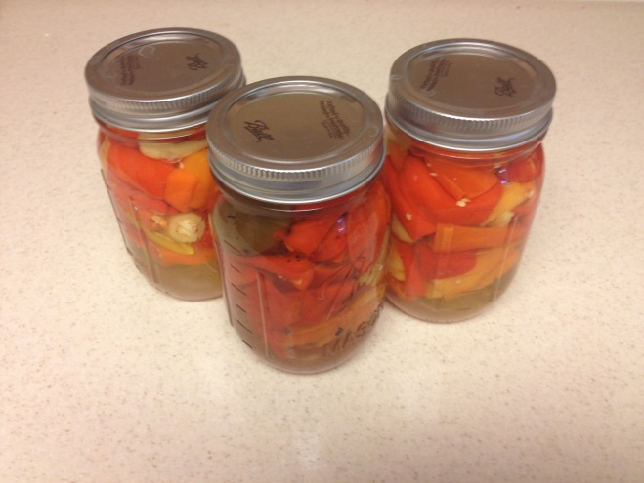
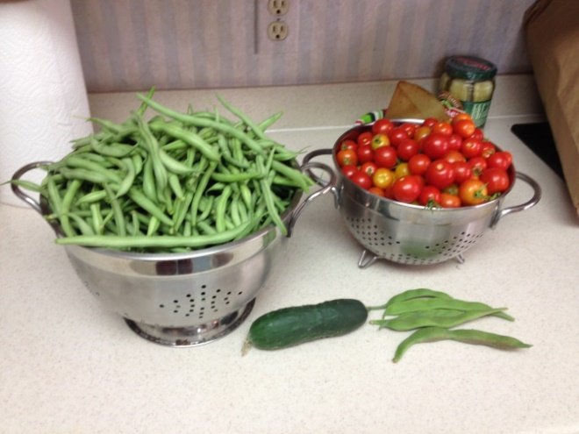
Garden Planning
Considerations
Which vegetables do you like?
What will you do with any surplus?
Do you have the right tools?
Labor? Money?

Slide 5
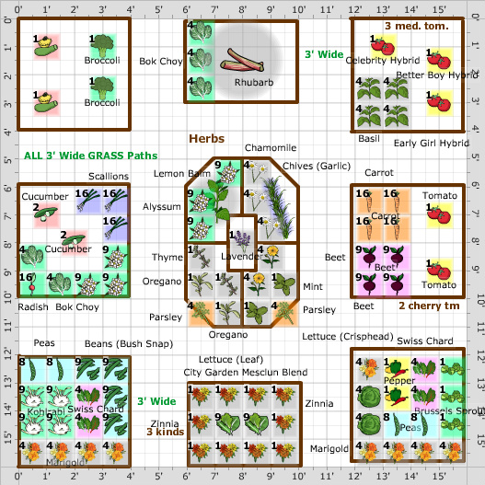
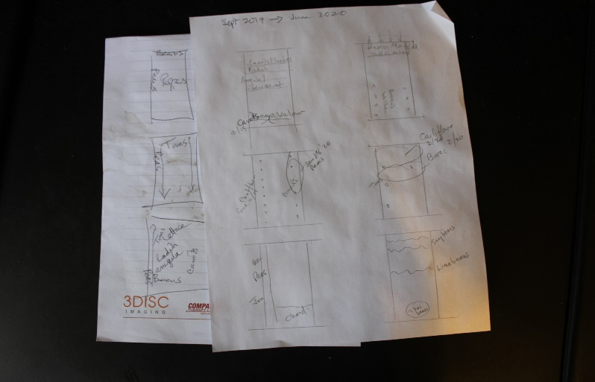
Garden Design
Start with “Florida Vegetable Gardening Guide”
http://edis.ifas.ufl.edu/vh021
Draw a plan on paper
*
Notes:
At this point - some time should be devoted to reviewing the wealth of information in the Florida Vegetable Gardening Guide:
In particular, the importance of using varieties adapted to Florida should be stressed.

Slide 6
Garden Planning - Crop Arrangement
Group by family (for crop rotation)
By planting/maturation dates
By plant size (tall, medium, short)
Similar spacing (ex: diff beans/same row)
Herbs and long season crops together
Notes:
Explain importance of rotation Pole beans and corn. Tall crops should not shade smaller plants.
Underplant with greens

Slide 7
A Great Resource...
Author: Jim Stephens
University Press of Florida
www.upf.com
Also on Amazon
~$16.95
Notes:
Go to UPF. Great resource. Many Florida Gardening books

Slide 8
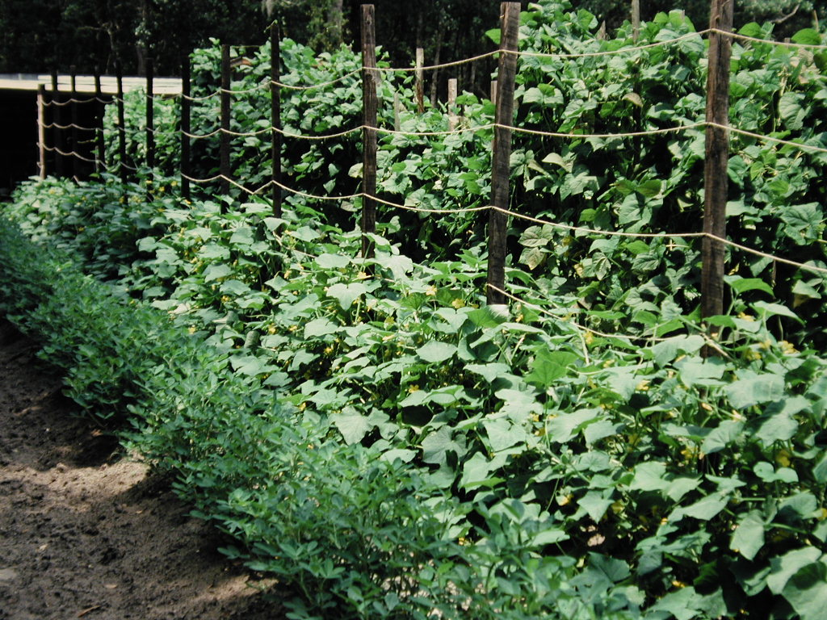
The Old Way

Slide 9
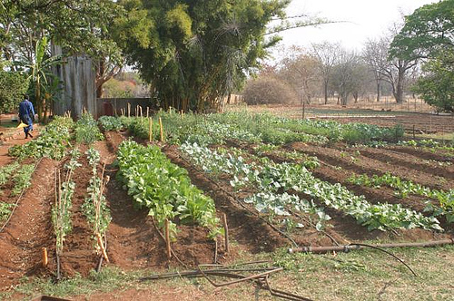
Winter Veggies

Slide 10
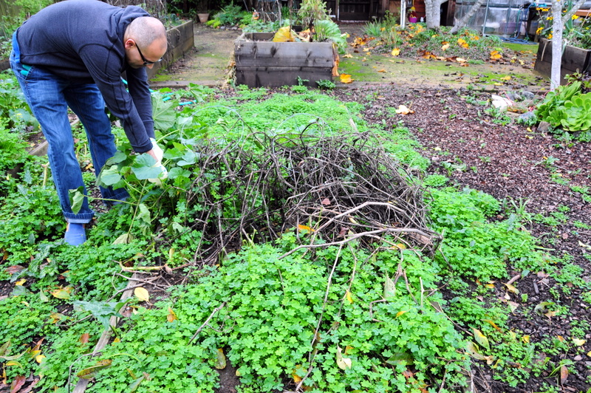
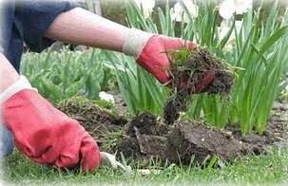
The Old Way Means Work
Weeding and Watering=Work

Slide 11
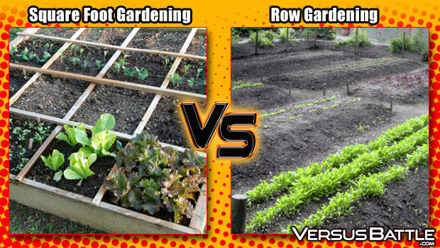
Maybe there is a more efficient way……

Slide 12
Grow Boxes/Raised Beds
Construction
4 feet wide
4-8 feet long
6-12 inches high
24 inches high for wheelchairs
Materials variable
Lumber: use cedar, cypress, composite, plastic or pressure treated lumber (post 2004)
In raised bed, you create your own soil
*
Notes:
Raised bed kits available. Go on line!

Slide 13
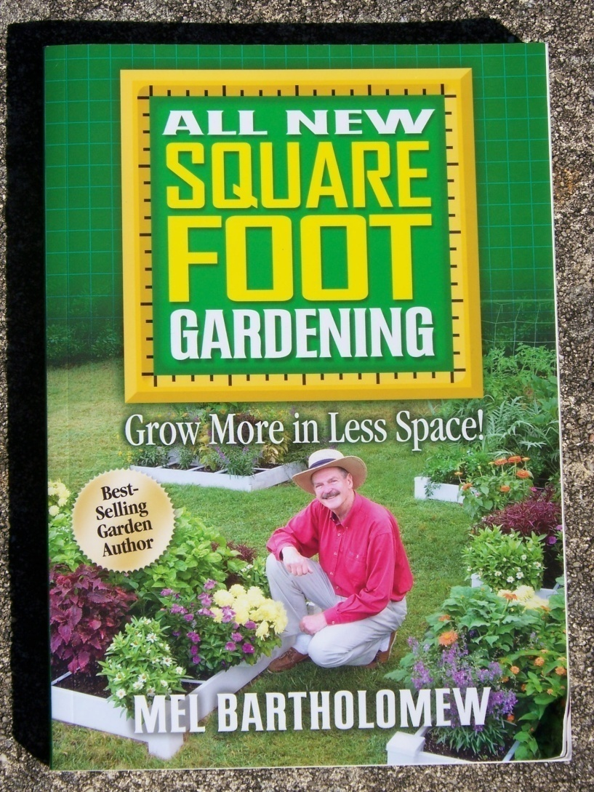
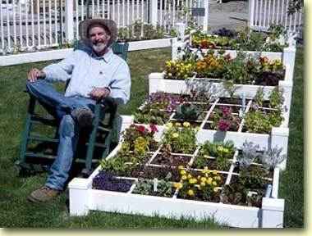
Square Foot Gardening
Square Foot Gardening is a method of raised bed gardening
Notes:
Available on Amazon. I follow some principles but not all.

Slide 14
What is Square Foot Gardening?
“”A simple, unique and versatile system that adapts to all levels of experience, physical ability, and geographical location”.
Grow all you want and need in only 20% of the space of a conventional row garden.
Save Time, Water, Work, $$$$

Slide 15
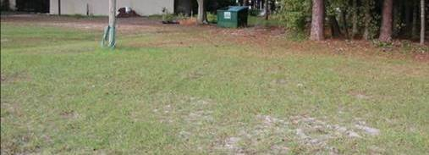
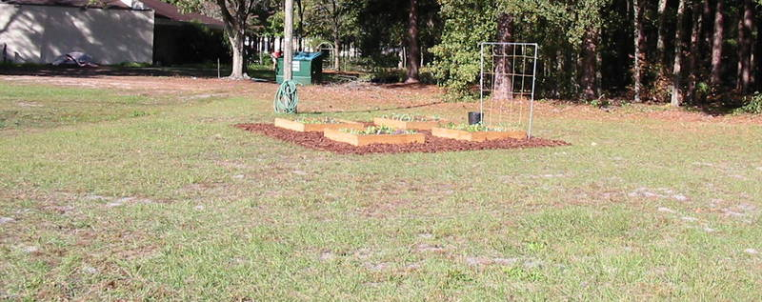
Location Location Location

Slide 16
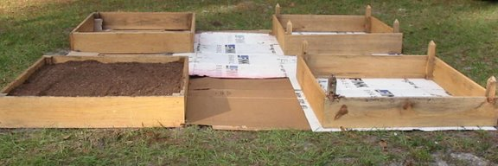
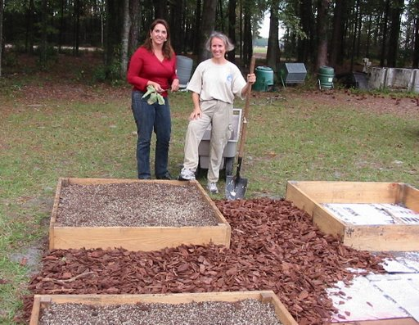
Garden Set Up
Build boxes 4ft square to hold soil 6 inches deep
Use a weed barrier like cardboard or weed cloth
Space boxes 3’ Apart
Mulch aisles for weeds (pine bark best)
Marine plywood for bottom if elevated

Slide 17
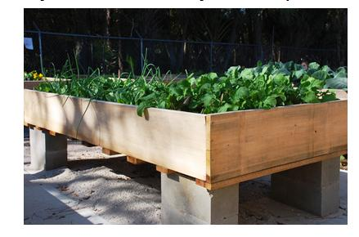
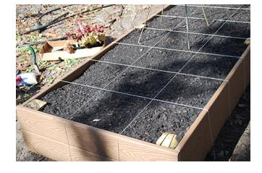
Alternative Methods
Notes:
Elevate!

Slide 18
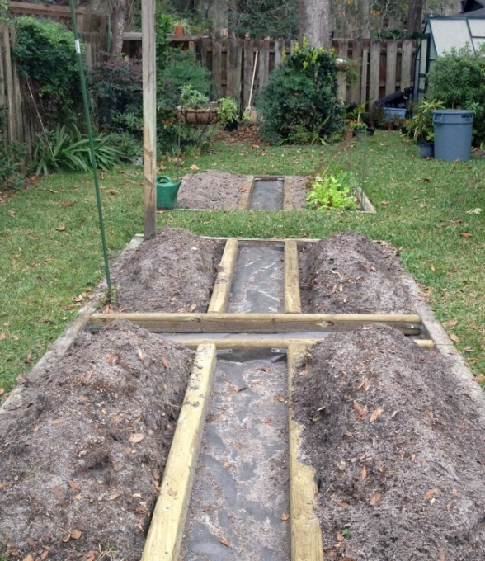
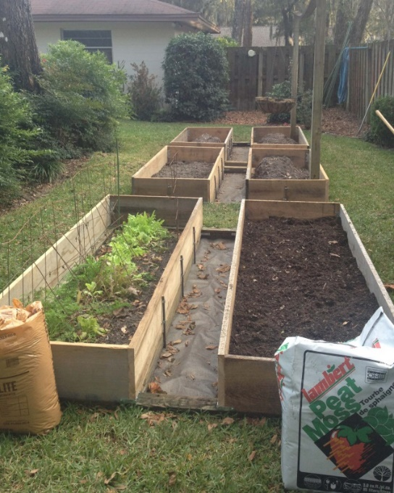
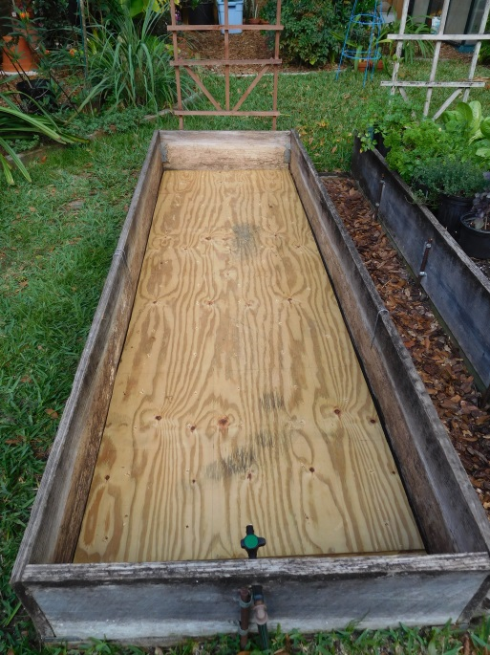
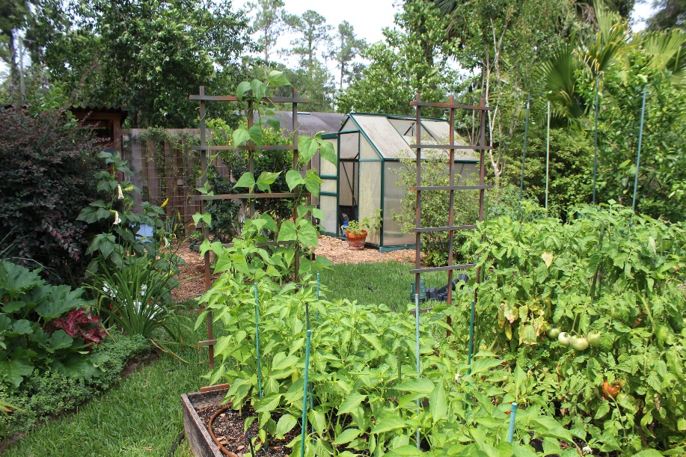
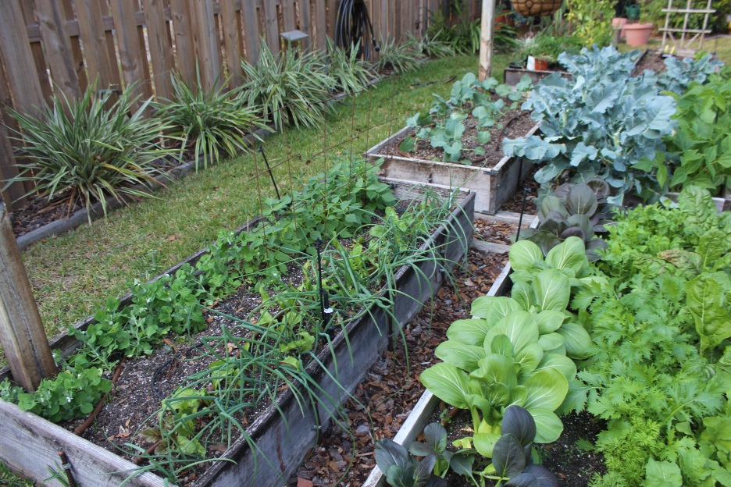
My Raised Beds
Notes:
Tell story of how they came to be and why so narrow (2 trees on right and fence on left. Trees now gone Orients NS

Slide 19
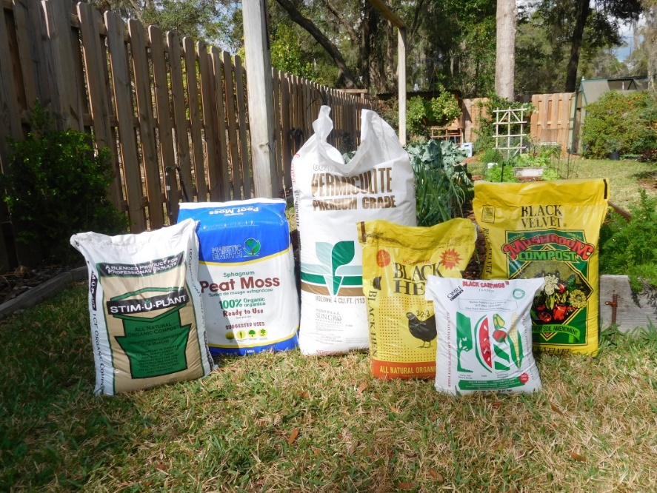
Prepare Soil Mixture (Mel’s Mix)
1/3 Blended Compost
1/3 Peat Moss
1/3 Coarse Vermiculite
Mix Well
Never Step on Soil
No Fertilizer Needed

Slide 20
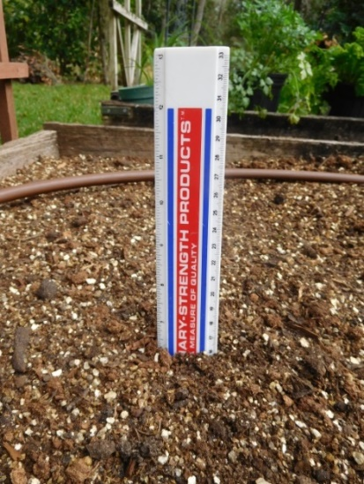
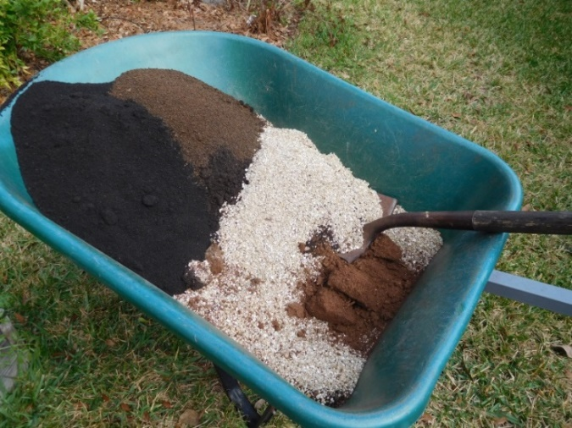
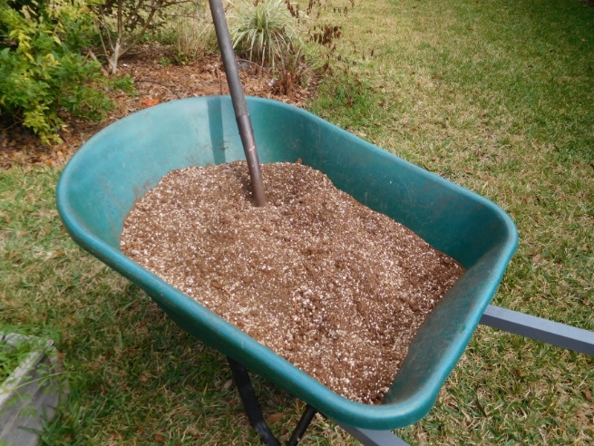
Mel’s Mix Soil Recipe
8 spades peat
8 spades coarse vermiculite
2 spades each of Black Hen,
Black Cow, Mushroom and
Worm castings
OR 8 spades of your own compost-and repeat until bed is 6” deep
Notes:
Box stores for peat and mushroom and Black Cow compost. Alachua Feed and Seed for vermiculite, Black Hen and worm castings.
Make your own worm farm.
NB Peat is non sustainable. Coconut coir is renewable but much more expensive….

Slide 21
You can also purchase pre-mixed soil
Bags of potting mix or raised bed soil
It takes about 1 cubic yard to fill a
4’ x 4’ bed that is 6 inches high
Add vegetable fertilizer if not Mel’s Mix
There are several sources in the area
Notes:
Bags are usually 1.5 cuft Mushroom (Black Gold is 40lbs)

Slide 22
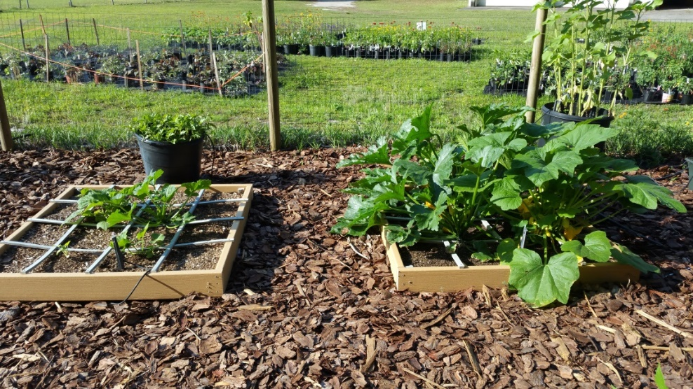
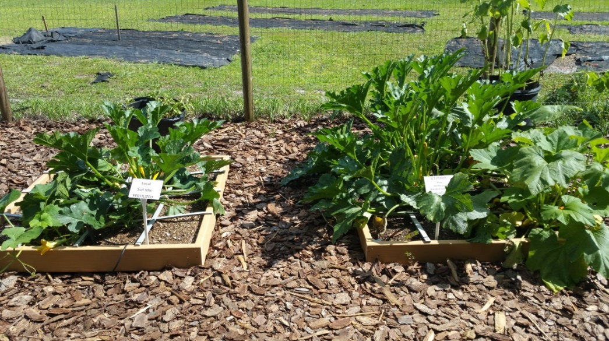
Local soil (with fertilizer) vs. Mel’s mix (no fertilizer)
Four zucchini/squash were planted at the same time in the same locations
The box on the left had local soil mix with 3 applications of fertilizer
The box on the right had Mel’s mix with no fertilizer
May 9, 2016
May 21, 2016
Notes:
Credit Denise

Slide 23
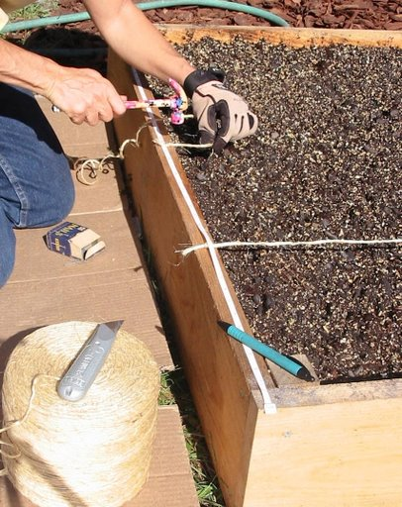
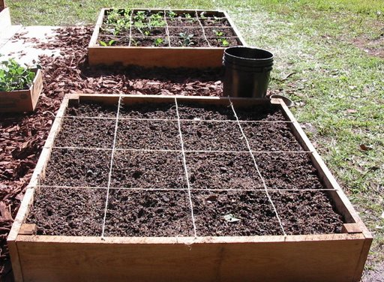
Square Foot Grid
Make 12” Squares
Fasten Grid Strings or Wood Lath

Slide 24
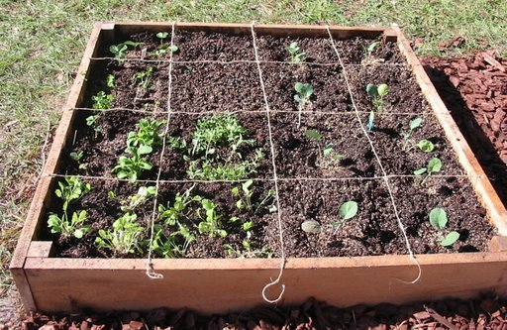
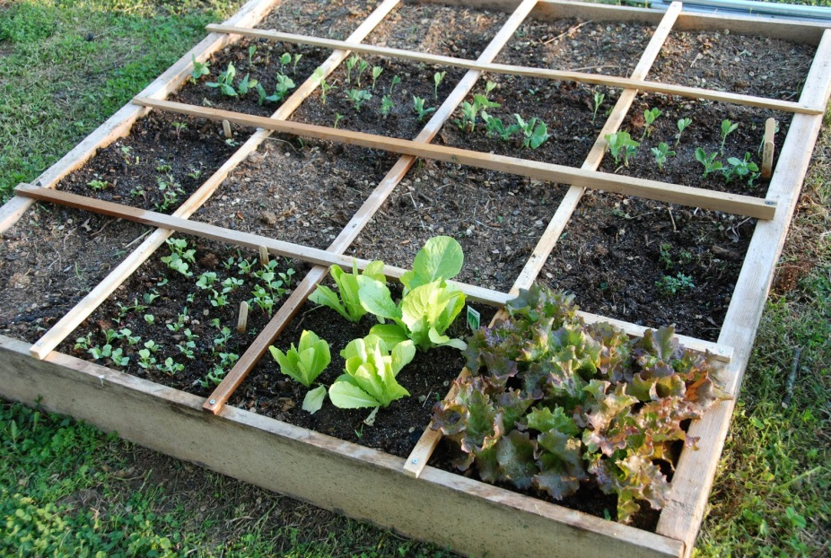
Select Plants
Plant a different Vegetable or herb in each square
Space Small, Medium, Large Plants:
1, 4, 9, 16 Plants per sq ft

Slide 25
Warm Season Vegetables
*Bush beans
(Mar–Apr)(Aug–Sept/Oct)
*Pole beans
(Mar–Apr) (Aug–Sept)
Corn
(Mar–Apr) (Aug)
Cucumber
(Feb–Apr) (Aug–Sept)
Eggplant
(Feb–July)
Okra
(Mar–July)
*Peppers (sweet & hot)
(Feb–Apr) (July–Aug)
Squash
(Mar–Apr) (Aug–Sept)
*Tomatoes
(Feb–Apr) (Aug)
Pumpkins
(Mar–Apr) (Aug)
Watermelon
(Mar–Apr) (July–Aug)
Cantaloupe
(Mar–Apr)
Sweet potato
(Mar–June)
*Malabar Spinach
(Mar-July)
Notes:
Okra, peppers and Malabar spinach go through the summer.
Facebook Grow Gainesville and our MGV FB page

Slide 26
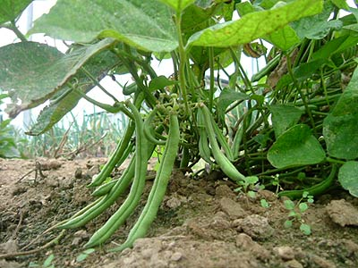
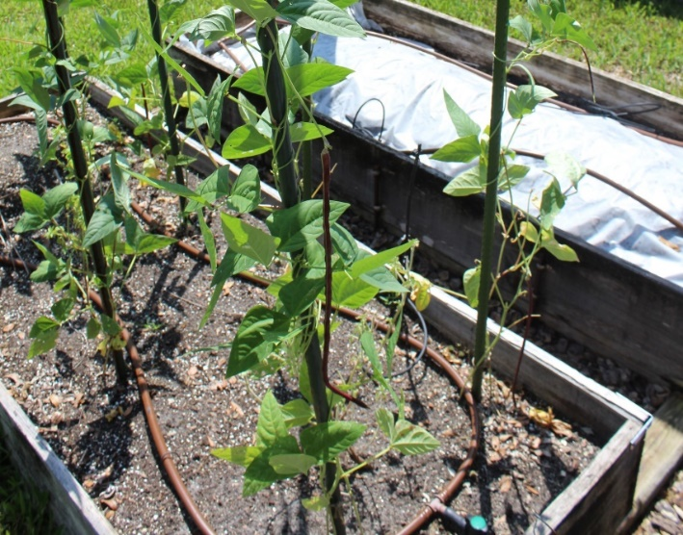
Beans
Snap Bush: Blue Lake, Contender, Roma, Mascotte, Provider,
Shell: Lima, Pinto, Red Kidney, Black Bean, Navy
Pole: Kentucky Wonder, Blue Lake, Matilda, Kentucky Blue, Thai Purple long bean
Plant Mar–Apr, Sept-October for TG and Christmas
50–60 days to harvest
Notes:
Some beans come in all at once and are good for canning (eg Blue Lake), others mature in progression for longer pick
I plant 15” row beginning of Sept and sequentially every 2 w

Slide 27
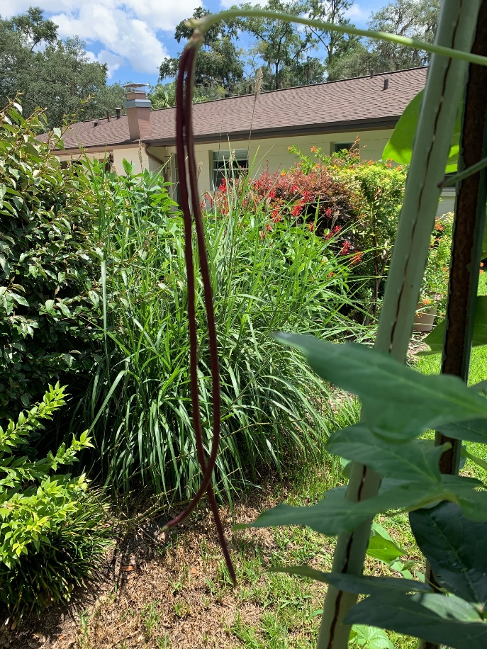
Bean; Long Thai Purple Padded Yard
Thai purple beans go through the summer
I usually plant in late June when my other beans are on the way out.
Harvest when thin
Matures quickly
Notes:
This image taken August 1

Slide 28
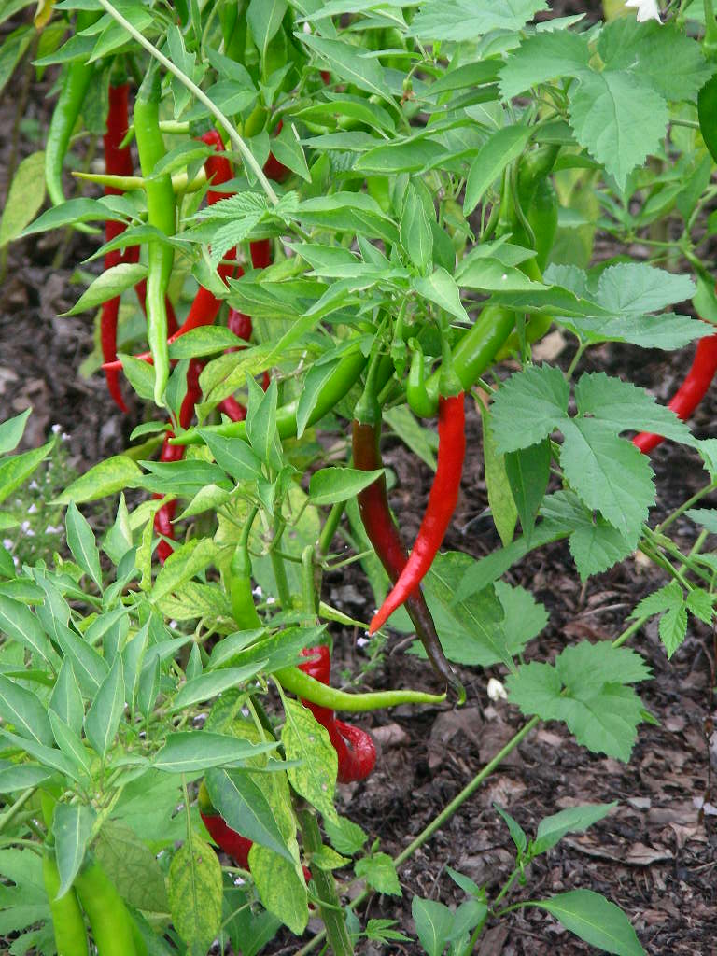
Peppers
Bell: California Wonder, Red Knight, Big Bertha
Other Sweet: Sweet Banana, Mariachi, Cubanelle
Jalapeno: Early Jalapeno, Jalapeno
Specialty Hot: Cherry Bomb, Hungarian Hot Wax, Big Chile II, Numex, Ancho, Anaheim Chile, Long Cayenne, Habanero, Plant Feb–Apr
Harvest in 80–100 days
Notes:
Raise from seed indoors in Feb or March. Transplant after last frost (usually Mid March) Buy from Farmers Mkt
6 pack a lot

Slide 29
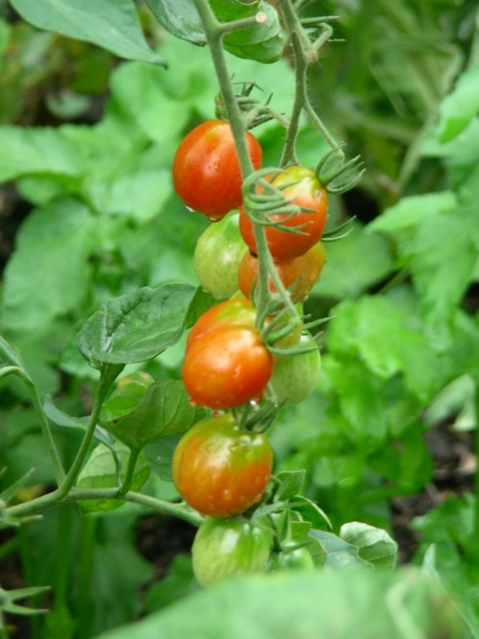
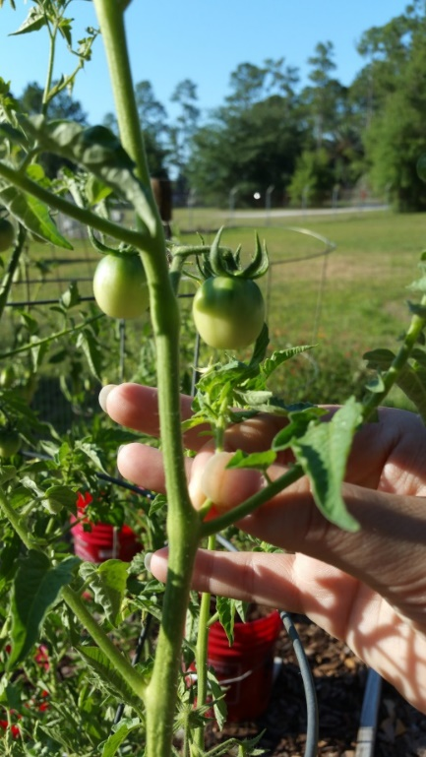
Tomatoes
Determinate vs Indeterminate
Large Fruit: Celebrity, Heat Wave II, Better Boy, Beefmaster, BHN444-Southern Star, Amelia
Small Fruit: Sweet 100, Juliet, Red Grape, Sun Gold, Sugar Snack, Maskotka, Sweet Baby Girl, Tumbling Tom
Heirloom: Green Zebra, Cherokee Purple, Eva Purple Ball, Brandywine, Yellow Pear
Plant Feb–Apr or August to Sept for fall crop
90–110 days to harvest
Notes:
Heat resistant: Sweet 100, Heat Wave II, Florida Everglades, Floragold, Tasti-lee

Slide 30
Malabar Spinach
Originated in India
Flourishes in hot climates
Not a real spinach but can be treated as such
Needs structure to climb
Seeds readily

Slide 31
Cool Season Vegetables
Beets
(Sept–Mar)
*Broccoli
(Aug–Feb)
Cabbage
(Sept–Feb)
*Carrots
(Sept–Mar)
Cauliflower
(Aug–Oct) or (Jan–Feb)
Chinese Cabbage (Pak Choi)
(Oct–Feb)
Collards
(Aug–Nov)
Turnips
(Jan–Apr) or (Aug–Oct)
*Lettuce
(Sept–Nov) & (Mar–May)
*Mustard greens
(Sept–May)
Arugula/Mesclun
Onion bulb
(Sept–Dec)
Onion multi
(Aug–Mar)
*Pea
(Jan–Mar) (Oct-Nov)
*Potatoes
(Jan–Mar, Sept-Oct)
*Spinach
(Oct–Nov)
Strawberry
(Oct–Nov)

Slide 32
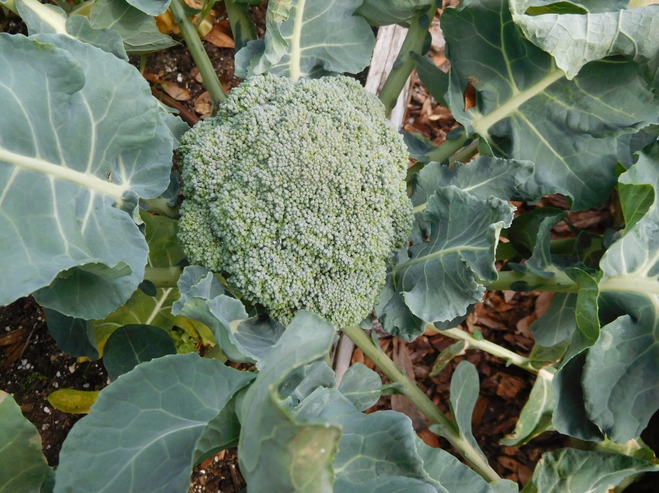
Broccoli
Early Green, Early Dividend, Green Sprouting/Calabrese, Waltham, Packman, De Cicco
Broccoli Raab (Rapini)
Plant in Aug–Feb
Seeds or transplants
75–90 days to harvest

Slide 33
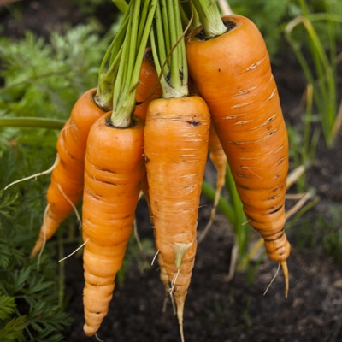
Carrots
Imperator, Nantes, Chantenay,
Rainbow blend
Plant Sept–Mar
Seeds work best
Very small-care in thinning-use fine scissors
Can take up to 80 days to harvest
Notes:
Hard to transplant. Sow into soil and thin. Last a long time in ground or in fridge. Harvest a bit before they get like above

Slide 34
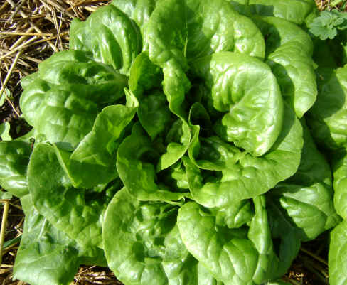
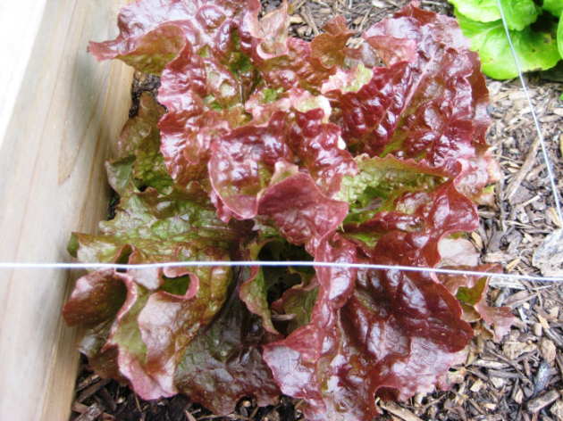
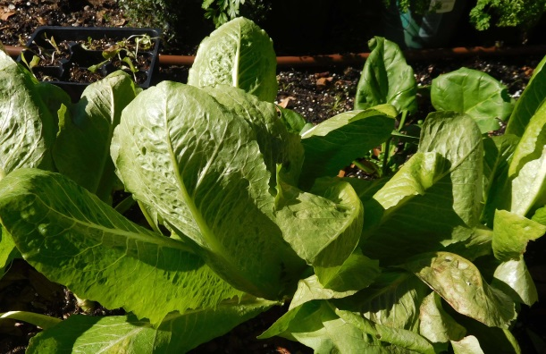
Lettuce
Crisphead: Great Lakes
Butterhead: Ermosa, Bibb, Tom Thumb, Buttercrunch,
Loose Leaf: Simpson types, Salad Bowl, Red Sails, New Red Fire
Oak Leaf: Salad Bowl, Royal Oak
Romaine: Parris Island Outredgeous, Green Towers
Plant in Sept-Oct and Feb-Mar
50-90 days to harvest

Slide 35
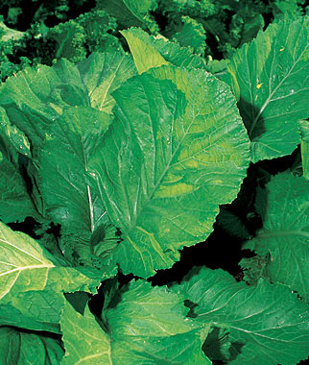
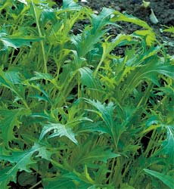
Mustard
Southern Giant Curled, Florida Broad Leaf, Tendergreen, Giant Red, Green Wave, Mizuna
Arugula or Rocket
Mesclun
Plant Sept-May
40-60 days to harvest
Notes:
Plant a few seeds sequentially or they will get ahead of you in this climate. Arugula gets spicy when mature. The traditional mesclun mix contains various tender lettuces such as chicory, arugula and endive. Sprinkle the seeds over the top of the soil, aiming to get them about 1" apart. Cover the seeds with 1/4" of soil. Water well. Harvest largest when germinated

Slide 36
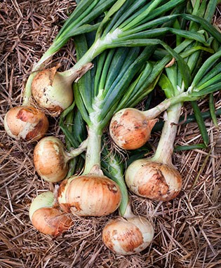
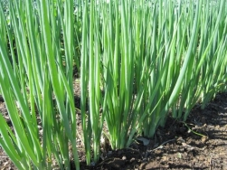
Onions
Onion Bulb
Usually bought as “sets” or small plants
Granex (yellow)
Sept–Dec
120–160 days to harvest
Thin and use as scallions
Onion Multi
Evergreen Bunching, White Lisbon Bunching
50–75 days to harvest
Notes:
Alachua Feed and seed have in now.

Slide 37
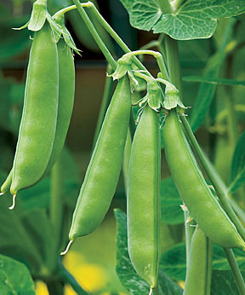
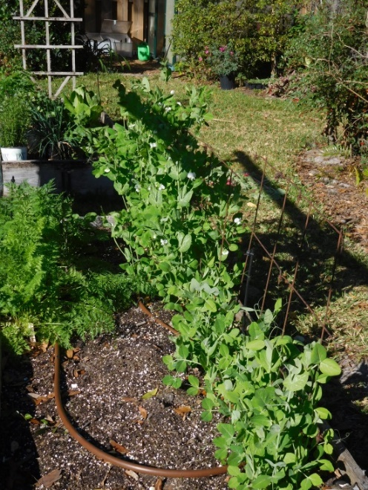
Peas
3 types: snap, shell & snow
Wando, Green Arrow, Sugar Snap, Oregon, Sugarpod II
Tom Thumb for containers
Plant Jan–Mar or Oct-Nov
50–70 days to harvest
Plant Oct for new peas at Christmas!
Never plant in same place in consecutive years

Slide 38
Potatoes
Red Pontiac, Yukon Gold, Gold Rush
Plant in Jan–Mar
85–110 days to harvest
“Hill” as they grow
Alternative is potato tower
Notes:
Potatoes take a lot of space. Buy seed potatoes from Alachua Feed and seed. Do not use store plants. Do not have to plant whole potato. Cut into pieces with one “eye” showing. Plant in trench and hill

Slide 39
Spinach and Swiss Chard
Melody, Bloomsdale Longstanding, Tyee, Space
Chard-will go into the heat too
Lucullus, Eldorado
Bright lights
Fordhook giant
Plant in Oct–Nov
40–55 days to harvest
Notes:
Buy transplants locally or from Farmers Market Good from seed but plant a small number in old 6 pack and get ready to transplant when roots appear at bottom of container
Tyee heat resistant and late bolter

Slide 40
Plant Spacing
1 Extra Large Plant per Square
Pepper, Broccoli, Cauliflower, Cabbage, Tomato
4 Large Plants per Square
Lettuce, Marigolds, Chard
9 Medium Plants per Square
Spinach, Turnips, Beans
16 Small Plants per Square
Carrots, Onions, Beets
32 Very Small Plants per Square
Radishes

Slide 41
Plant Spacing Diagram

Slide 42
ALLOW SPACE!

Slide 43
Spacing Florida Style
Sometimes we need to adjust the spacing.
Zucchini 1 per 4 squares or let climb
Large Tomato plants 1 per 4 squares

Slide 44
Vertical Gardening
Vertical Frames at North End
Don’t Shade Garden
Frame or Pipe 4’x7’
String or Net or on fence
Hanging baskets

Slide 45
Vertical Gardening
Plants Per Square Foot | Plants Per Two Square Feet
Gourd (1) | Melons (1)
Tomatoes (1) | Pumpkins (1)
Cucumbers (2) | Summer Squash (1)
Pole Beans (8) | Watermelon (1)
 | Winter Squash (1)
Here is how much room you need for each vine crop

Slide 46
Tomatoes
Leave only a single stem on indeterminate snip suckers
Wind them through netting or tie to stakes
Notes:
Do not plant in same bed each year, same for peas and peppers. Thinning allows air flow and reduces chance of disease Nip top when they get as high as your stakes.

Slide 47
Plan for Pollinators
Use flowering plants to bring pollinators in:
Zinnias
Buckwheat
Sunflowers
Agastache
Dill, parsley, garlic chives
Salvia
Coneflower
Marigolds

Slide 48
Vegetables Can be Grown in Pots
Fine for sunny patios or cramped spaces
Use regular potting soil or Mel’s mix
Chose appropriate plants
Water regularly
Notes:
I use my own compost at base and potting soil augmented with slow release fertilizer in top 1/3

Slide 49
Grow from Seed or from Transplants?
Notes:
If transplants in a six pack, stagger planting or all will ripen at once
LABEL plants

Slide 50
Sunflowers
can be used as trap crops for stink bugs and leaf-footed bugs
Notes:
I plant a lot of sunflowers in borders look good until the squirrels find them

Slide 51
Fertilization
Fertilize every 2-3 weeks if not using Mel’s Mix
Organic pelleted chicken manure
Fish emulsion?
10-10-10/8-8-8
Soil test?
Best to side dress
Notes:
If you just toss on the plant it will burn it especially if wet

Slide 52
Soil Test
Notes:
Noted that the top of the pepper was yellow with green veins. Soil test showed pH of 6.5. Too high for absorption of some minerals. Indicates a possible iron deficiency. Not N as lower leaves turn yellow first.

Slide 53
Water Your Garden
Water by hand
Or micro-irrigation on timer

Slide 54
Plan for pest control
Most problems can be controlled with an insecticidal soap like Safer Soap
Neem oil is also effective on insects and can have a fungicidal effect also
Use Bt (Bacillus thuringiensis) or manual removal for caterpillars
Complete list in Garden Guide Scout regularly
Ants can be treated with boiling water.
Treat early
Notes:
Tomato Hornworm

Slide 55
Trim off the dead leaves
Notes:
Maybe best not to compost if fungus

Slide 56
Root-knot Nematodes
Are microscopic parasitic worms that live in the soil in areas with hot climates. They bore into the plant roots and cause galls that inhibit the roots from taking in nutrients.
Notes:
Thank Doug

Slide 57
Nematodes
Root-knot nematode affects many cool-season crops.
Look for nematode-resistant varieties.
Add organic matter to your soil.
Solarize in summer.
Plant cover crops (Marigold,
Sunn hemp, Hairy indigo).
Nematode Management in the Vegetable Garden. http://edis.ifas.ufl.edu/ng005
Notes:
Talk about solarizing

Slide 58
Other pests….

Slide 59
Protecting Your Garden
Wire Fencing
Bird netting
Frost Cloth

Slide 60
Harvest Your Garden
Harvest when it looks how you would purchase it
Add new peat and compost
Replant with new and different crop
Keep a record!
Notes:
Be sure to keep a record of what you planted and when. Important to rotate crops

Slide 61
Bolting

Slide 62
Composting
Make your own compost to reduce costs and make garden sustainable
Notes:
Drums also Program on composting next month

Slide 63
Cost of Square Foot Garden
Lumber, hardware ~$40.00
3 Cu Ft Peat 12.48
3 Cu Ft Compost 61.02
Mushroom (Lowes) ($5.28 40lbs)
Black Kow ($8.50 1.5 cuft)
Chicken Compost (ALF&S)($20.99)
Worm Castings (ALF&S) ($21.99/20 lbs)
3 Cu Ft Coarse Vermiculite 29.50
Total ~$143.00
Notes:
Vermiculite is in paper sack. Do not get wet. Chicken compost smells and attracts critters. Store in waterproof and critter proof containers

Slide 64
Resources
Lumber - Most lumber yards or box stores
Soil mixture components (vermiculite, peat, compost) - Alachua Feed and Seed and retail garden centers
Pre-mixed soil – Local Nurseries (e.g.TNT, Green House, Watson C&D)
Irrigation – Lowes, Home Depot, Ace or Florida Irrigation
Transplants - Most garden centers and farmers markets
Seeds – Park Seed, Baker Creek Heirloom Seeds, W. Attlee Burpee, Johnny’s Seeds
All New Square Foot Gardening book, UF/IFAS Bookstore
Compost bins, Leveda Brown Environmental Park?
IFAS-EDIS for literature
Additional Resources https://www.greenhousemegastore.com/

Slide 65
Happy Growing!
Contact the MG Desk at the Extension Office with questions
mag@alachuacounty.us
352-955-2402
Or me at
burrowsc@ufl.edu
Like us on Facebook – facebook.com/alachuacountymastergardeners

